Slide 1
Final Portfolio
Anna Krawczyk

Slide 2
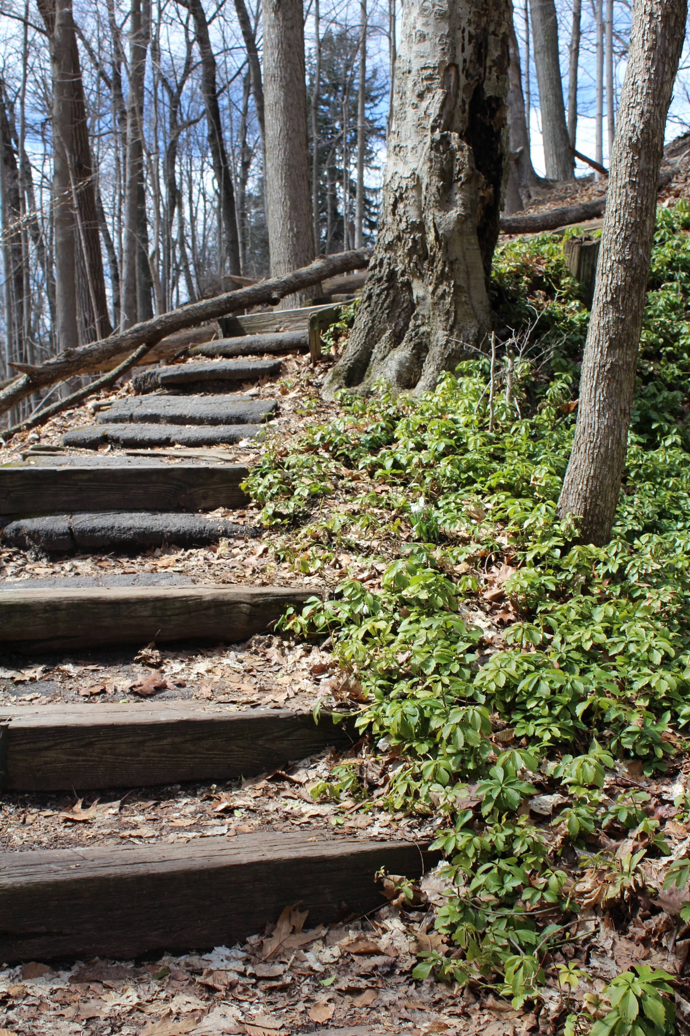
Form/Pattern (Repetition)
Name: Anna Krawczyk
Title: Keep Climbing
Location: Milwaukee, WI
Date: 3/27/2024
Caption: Wooden steps on a climbing trail lead up to the top of a bluff.
Note: This image illuminates the principles of form/pattern through the repetition of the wooden steps on this hiking trail. It really caught my eye because you don’t always see a lot of clear-cut repetition like this in natural spaces and it looks cool contrasted with the wildness of the shrubbery and leaves.

Slide 3
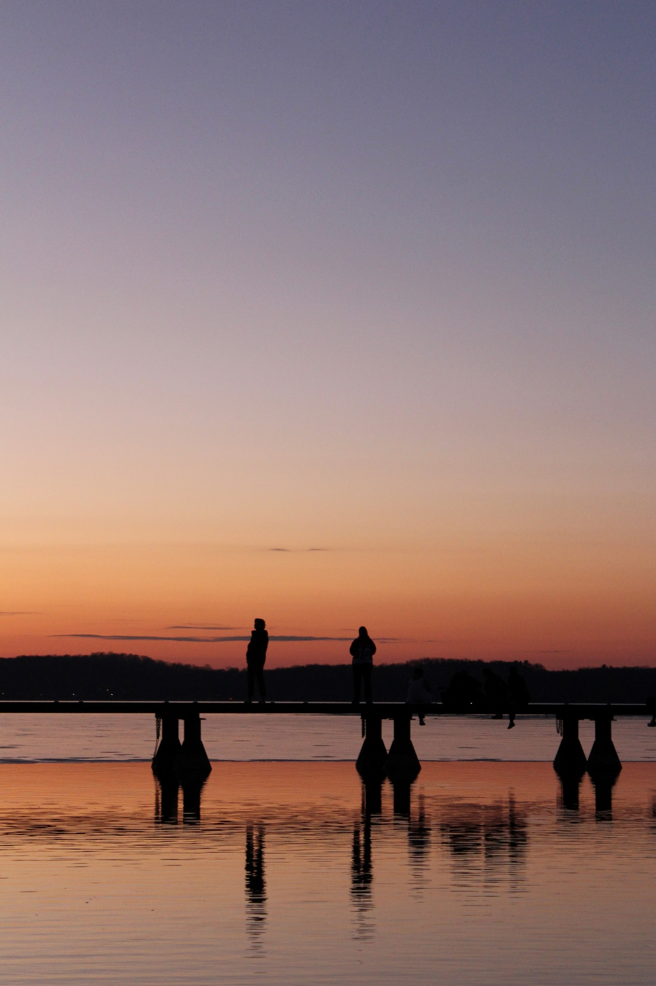
My Favorite Image:
Ambient Color/Light
Name: Anna Krawczyk
Title: Cold Weather, Warm Colors
Location: Madison, WI
Date: 3/1/2024
Caption: On a cold March evening, the sunset burns warm colors into the cold sky as onlookers watch.
Note: This image illuminates the principles of ambient light AND color because the color of the sunset really makes the image. It would probably look cool during the day too, but the reflection of the sunset on the lake and the people watching it really add to the photo, in my opinion.

Slide 4
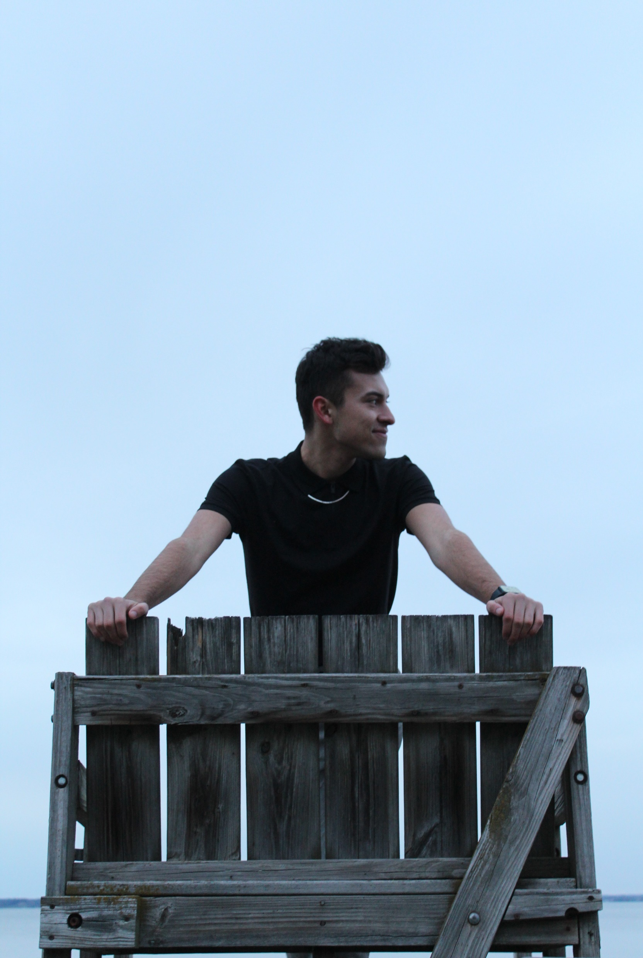
Expressive Portrait
Name: Anna Krawczyk
Title: Lifeguarding in March
Location: Madison, WI
Date: 3/21/2024
Caption: Noel, a former lifeguard, poses on an old lifeguard chair at James Madison Park on a chilly March evening.
Note: This image illuminates the principle of an expressive portrait because we got creative with the lighting and angles. Although you can’t tell, this lifeguard chair is pretty high up, which made it easier for me to capture the bright white sky in the background to contrast it against Noel’s black shirt and make for an interesting portrait.

Slide 5
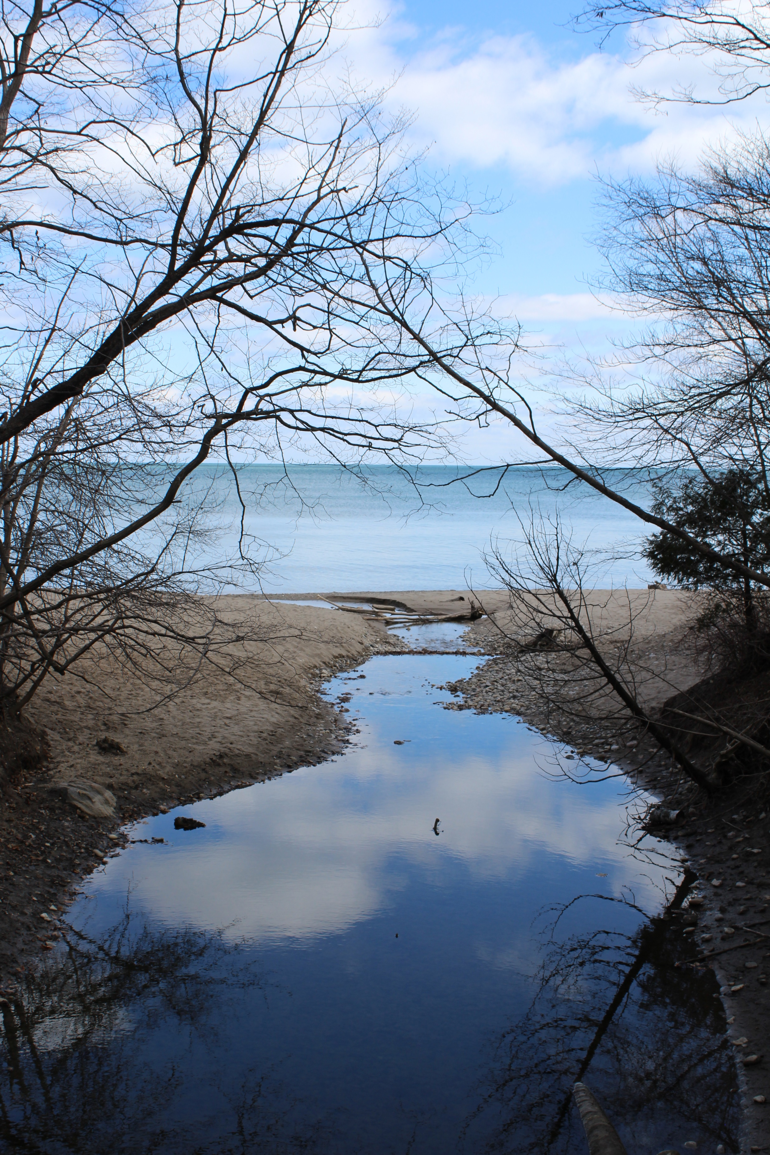
Juxtaposition
Name: Anna Krawczyk
Title: Reflections
Location: Milwaukee, WI
Date: 3/27/2024
Caption: A small stream runs through a ravine, splitting the land and eventually leading through towards Lake Michigan.
Note: This image illustrates the principle of juxtaposition because it not only shows contrast between water and land but also juxtaposes the two bodies of water. Lake Michigan in the background is a lighter, more green color while the smaller stream in the foreground is darker and shows more of the reflection of the sky and clouds.

Slide 6
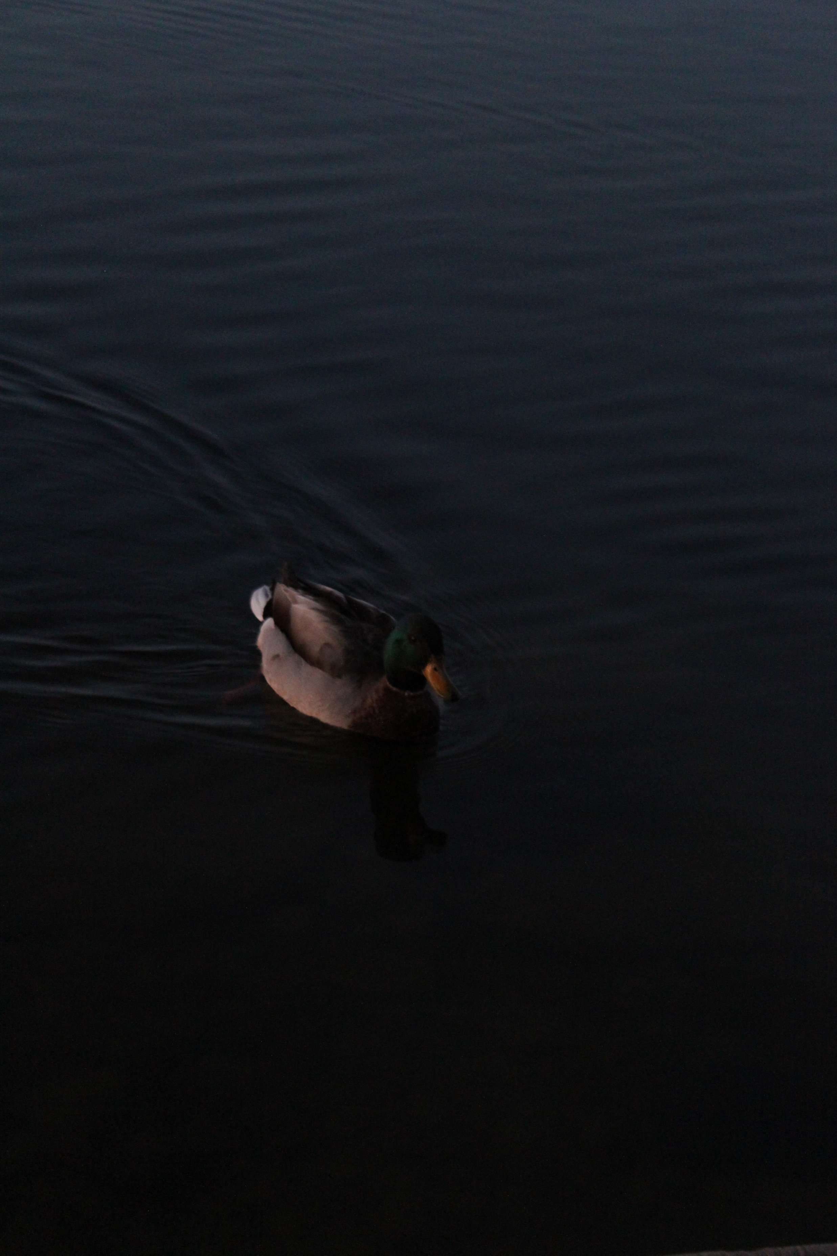
Movement
Name: Anna Krawczyk
Title: Mr. Mallard On the Move
Location: Madison, WI
Date: 3/1/2024
Caption: A male mallard duck swims through the dark evening water of Lake Mendota.
Note: This image illustrates the photographic principle of movement because it freezes on a moment of the mallard moving through the water. You can see the movement of the water behind the duck contrasted with the more still/rippling water to the side of him.

Slide 7
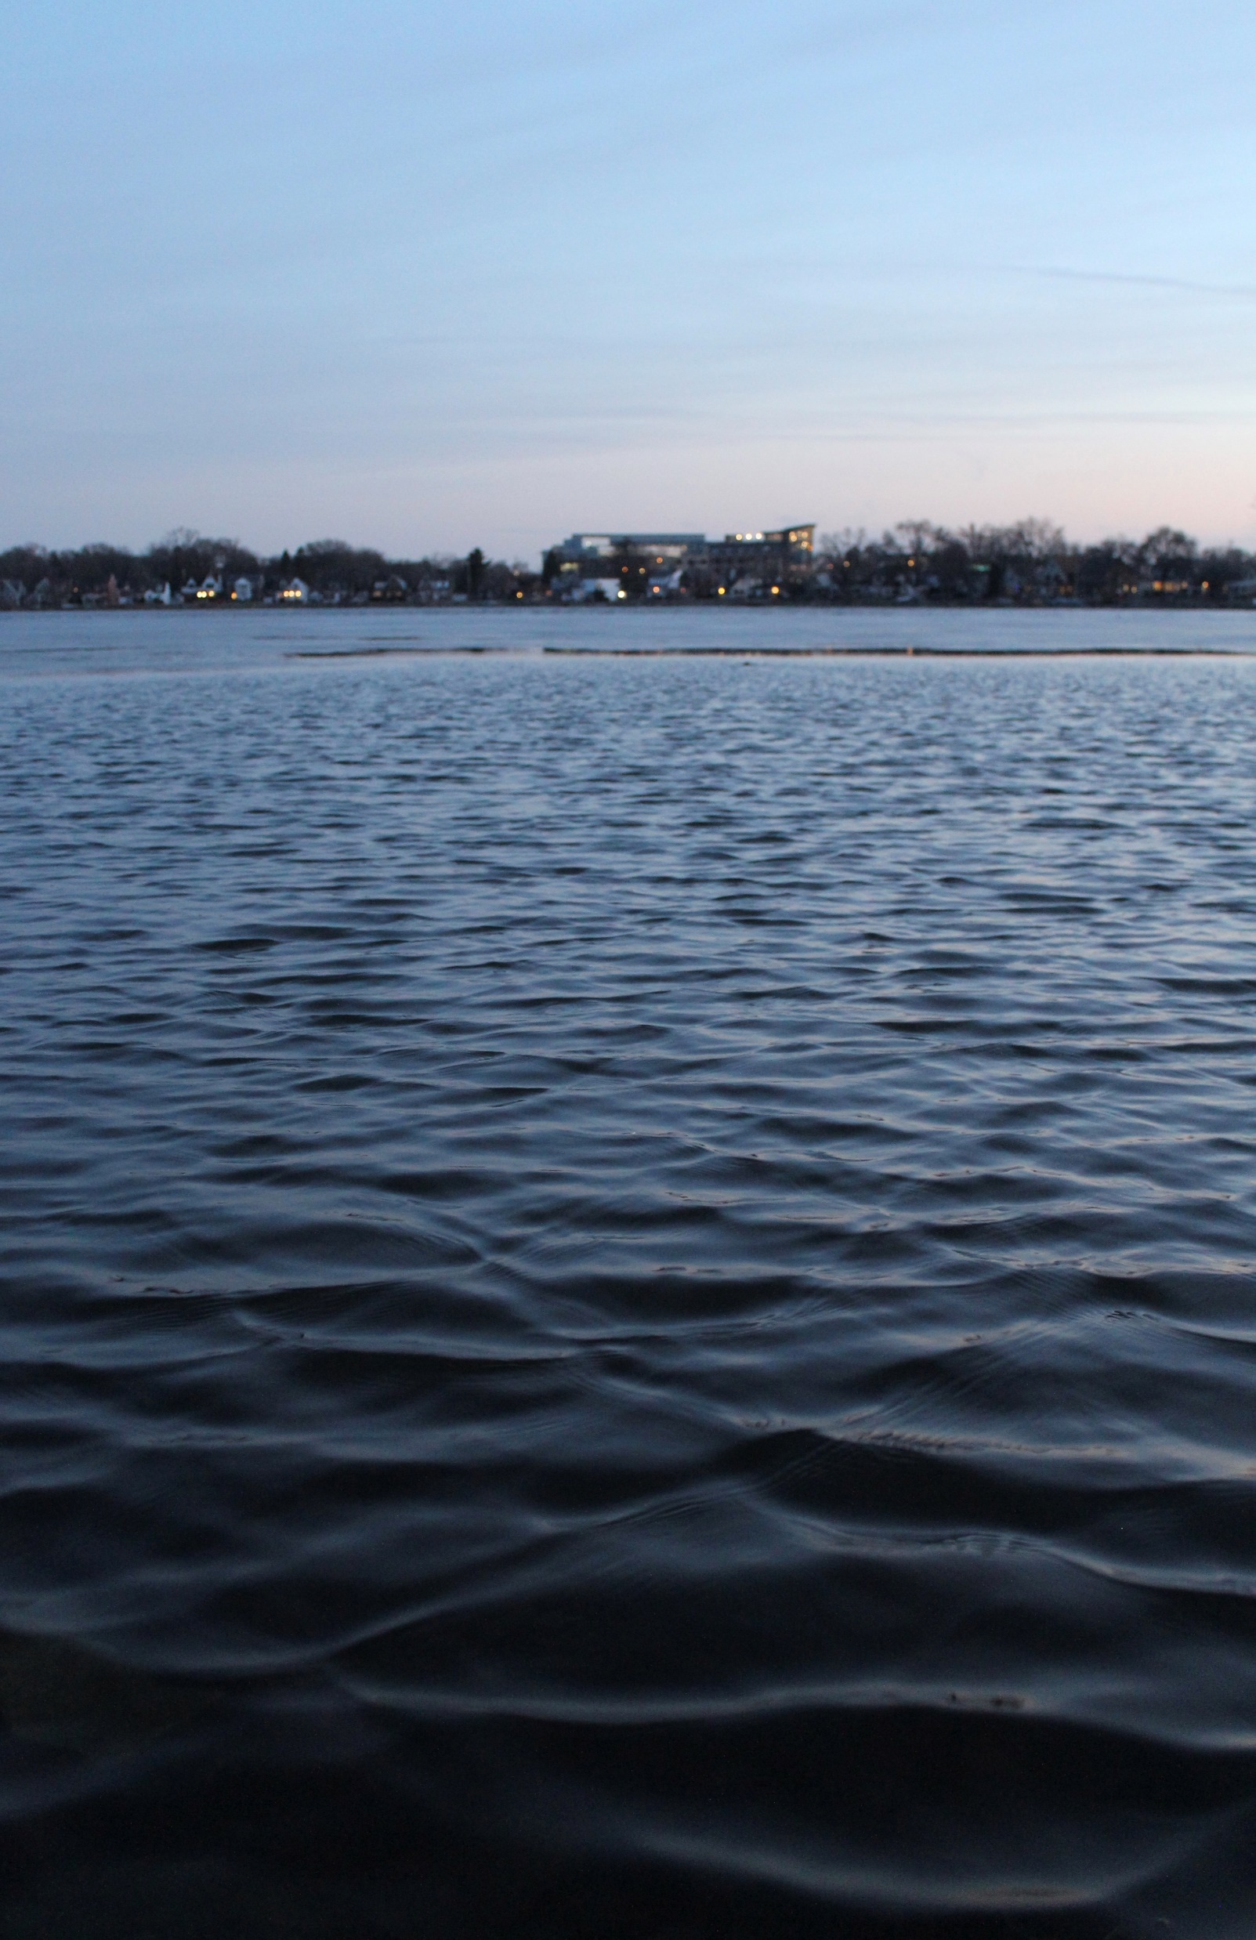
Visual Weight
Name: Anna Krawczyk
Title: Dive In!
Location: Madison, WI
Date: 2/26/2024
Caption: Water slowly laps across Monona Bay, with Park St. neighborhood peeking over the horizon line in the background.
Note: This image illustrates the photographic principle of visual weight because it uses a unique angle that puts most of the visual weight on the expanse of water rather than the sky or the horizon line. The water is the first thing you see in the image and the thing that keeps drawing your attention in.

Slide 8
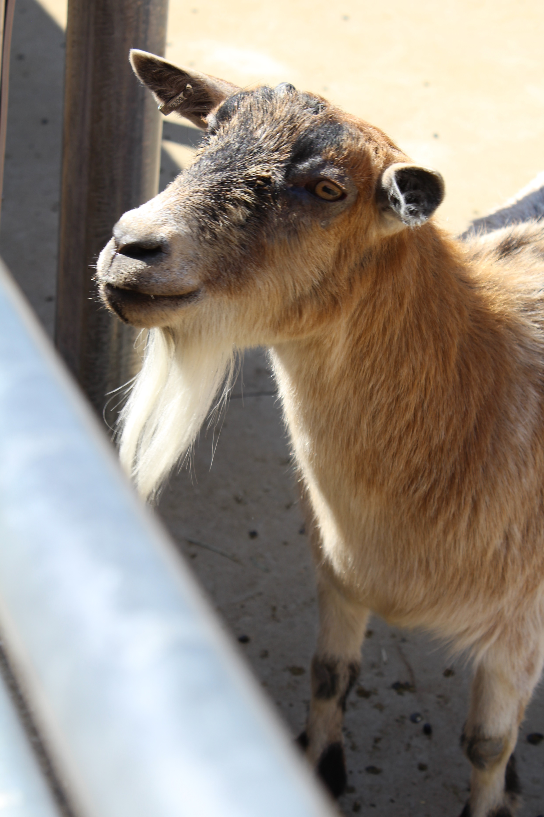
Decisive Moment
Name: Anna Krawczyk
Title: The Goat’s Gaze
Location: Madison, WI
Date: 4/21/2024
Caption: A goat at the zoo gazes up, anticipating snacks from children gathered around him off-frame.
Note: This image illustrates the photographic principle of the decisive moment because the goat looked over at me just at the perfect moment for me to get a good shot of his face that illuminates his eyes, ears, beard, and other features. The goats were moving quickly so it was initially hard to get a good shot, but luckily this decisive moment occurred.

